Slide 1
Housekeeping
Please put yourself on mute and turn notifications off
Feel free to use the chat function during the session
The session will be recorded

Slide 2
Words Matter
Julie Musesoglu (she/her), Senior Diversity and Inclusion Manager, Homes England
Michelle Seale (she/her), Social Value and Community Engagement Manager

Slide 3
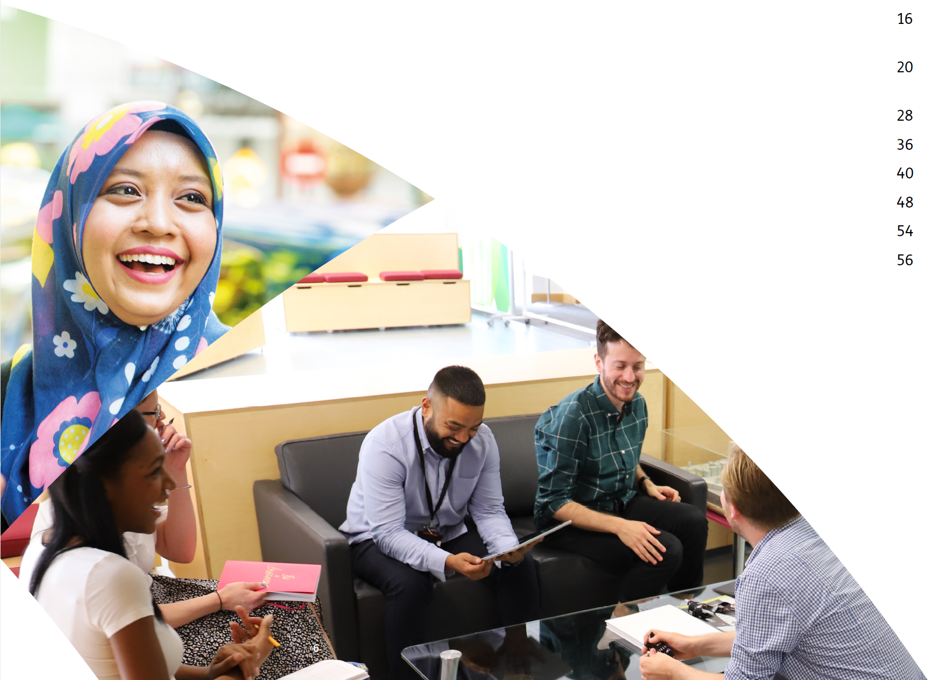
Today’s agenda
Introduction
Equality, diversity, inclusion and belonging
Words Matter – inclusive language
Understanding unconscious bias and intersectionality
What can you do?

Slide 4
Hello ☺
Where are you joining this session from?

Slide 5
Ways of working
This is a safe space - confidentiality, trust, openness and honesty are important
There will be interactive elements – please participate if you feel comfortable doing so!
We are all at different levels in our knowledge and need to respect that – no question is a stupid question!

Slide 6
Equality, diversity, inclusion and belonging

Slide 7
Equality, diversity, inclusion, belonging
Diversity
The collective mixture of differences and similarities in an organisation/group
Equality
Ensuring everyone has the same resources and opportunities, and that nobody is treated differently
Belonging
The feeling of being truly part of something
Inclusion
Ensuring different backgrounds are culturally and socially accepted welcomed and treated fairly.

Slide 8
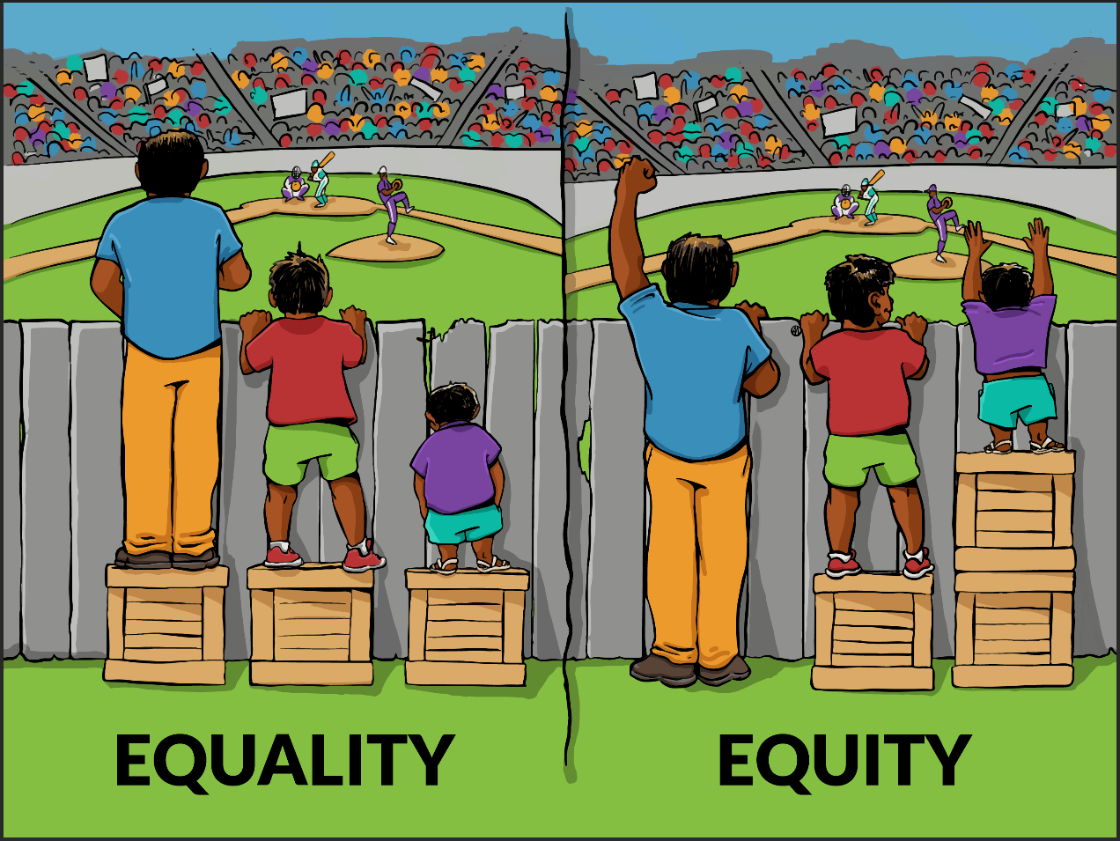
Equality vs Equity
Equality
Treating everyone the same
Equity
Treating individuals according to their needs

Slide 9
Why equality, diversity, inclusion and belonging matter?
Companies in the top quartile for gender diversity are 21% more likely to experience above-average profitability.
We want to attract and welcome the best talent
We do better when we can be ourselves at work
Increased creativity and innovation, better problem-solving and decision-making
We can influence others
We need an industry that reflects and understand well the communities we serve

Slide 10
Words Matter – Inclusive Language

Slide 11
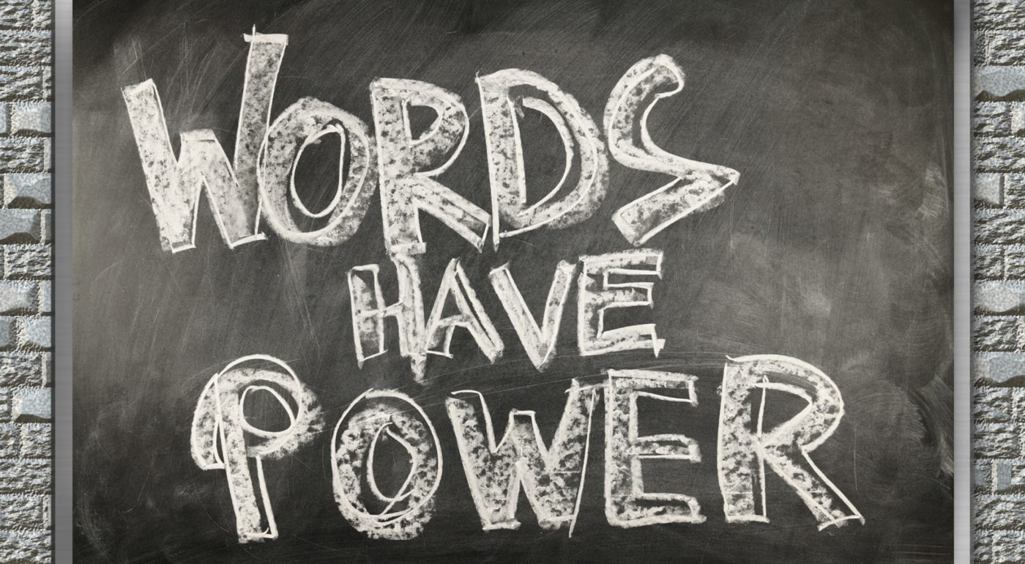
Inclusive language
Reflecting on the way we communicate means making the effort to understand the way that language unconsciously makes assumptions about people and
reinforces dominant norms.
Remember – our words have the power to:
Be hurtful
Make us less approachable
Offend
Create an inclusive environment
Generate kindness

Slide 12
Placeholder - video

Slide 13
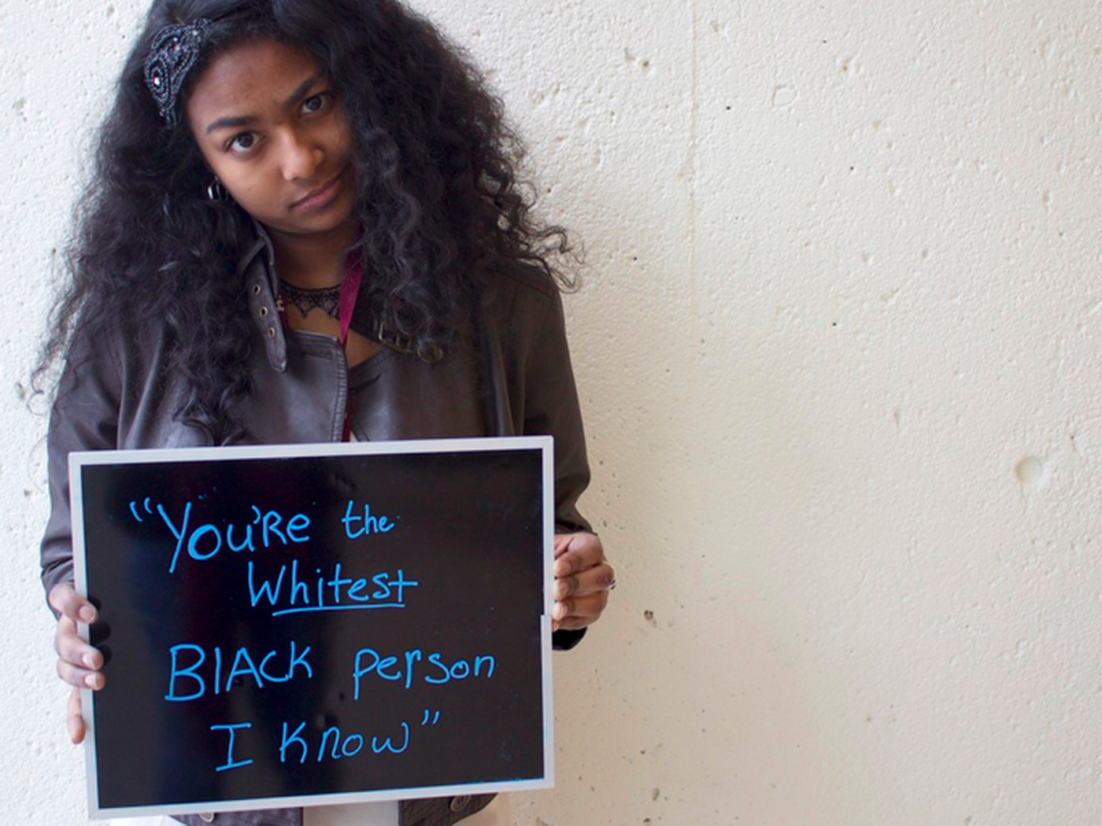
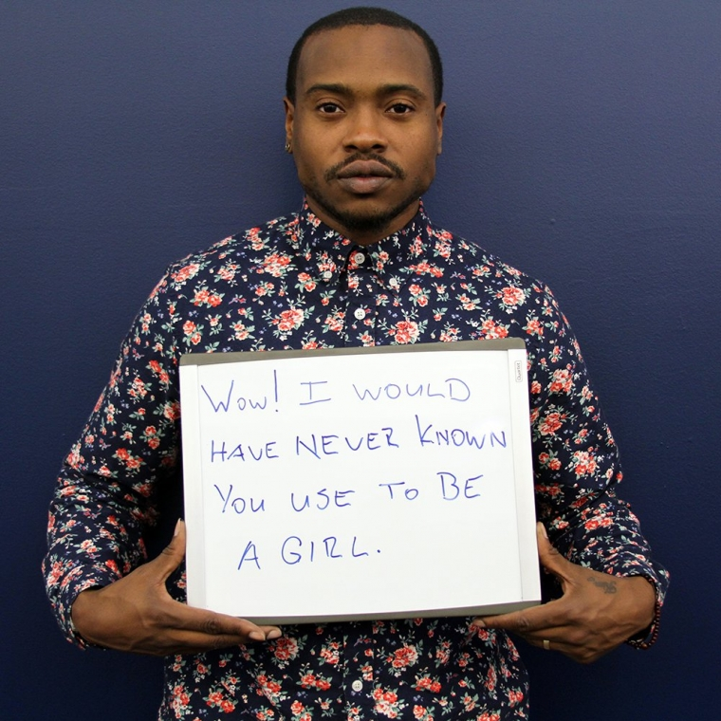
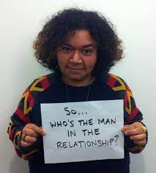
Microagressions

Slide 14
Ethnic and cultural diversity results in a 33% increase in performance.

Slide 15
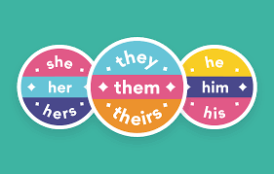
Pronouns
Five top tips for using pronouns:
Include pronouns when introducing yourself.
Put your pronouns in your email signature and/or social media profile
Try to avoid addressing groups or people with gendered language, e.g., instead of using ‘Ladies and Gentleman’, use the word ‘everyone’ to address a group
If you’re not sure what someone’s pronouns are, ask them (in a safe environment)
If you accidentally misgender someone, just apologise to them and then move on using their correct pronoun.
Ethnic and cultural diversity results in a 33% increase in performance.

Slide 16
Inclusive language – top tips
Avoid gendered language (e.g. ladies and gentlemen)
If you’re not sure how someone likes to be referred as, just ask
Some words that are acceptable for some, can offend others (e.g. queer)
When grouping people together into acronyms, remember to focus on each characteristic individually (e.g. BAME or LGBT+)
Getting language right is important, but action is more important than words.

Slide 17
Unconscious Bias

Slide 19
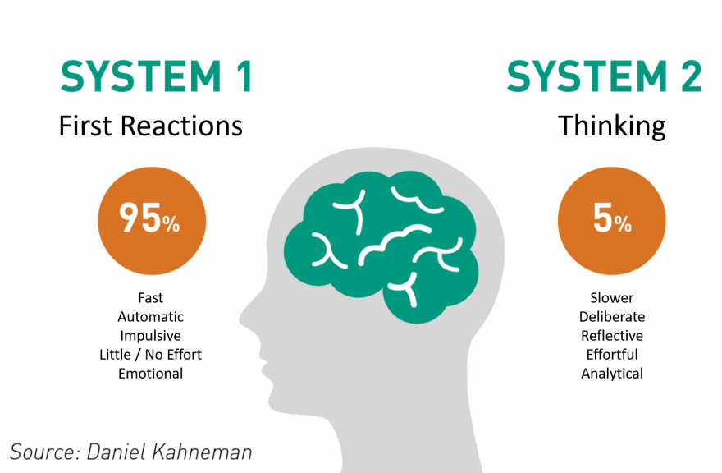
What is unconscious bias?
Automatic decision making process
Our brains take mental shortcuts
We categorise people unknowingly
This has an impact how we treat people

Slide 20
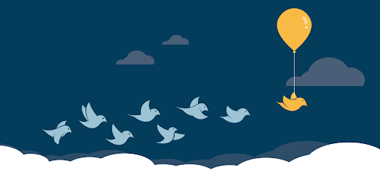
Remember…
Our biases are normal – we all have them
They inform part of our everyday decision making
Many of our biases stem from childhood
Once we’re aware of how our unconscious bias thought processes work, we can ‘catch ourselves’ in the moment
Our mindsets are not set in stone – we can break away from our cultural stereotyping and influences.

Slide 21
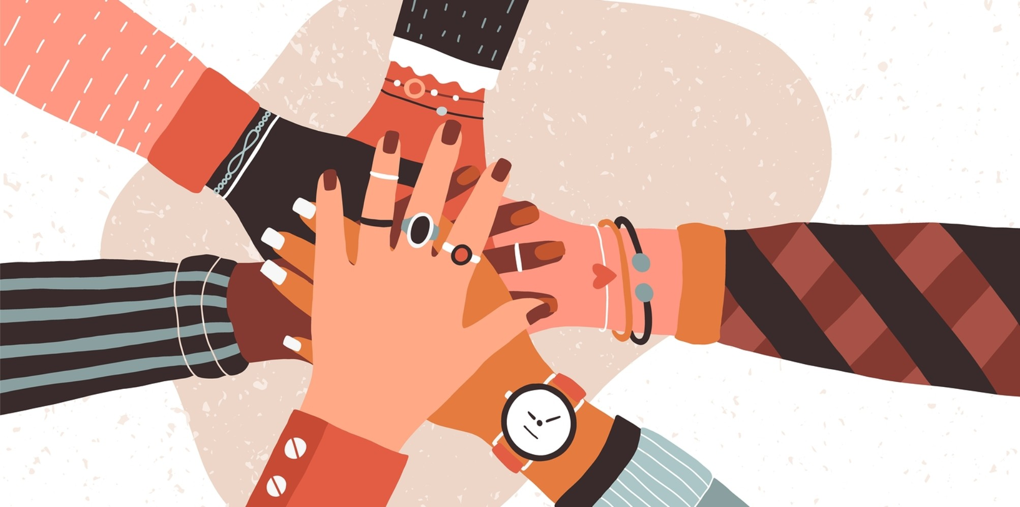
Moving from Unconscious Bias to Conscious Inclusion
Acknowledge your bias
Think about yourself, and the assumptions people may attach to you
Challenge your own assumptions and be willing to be proved wrong
Be curious – listen to, and learn about, people different from yourself
Ask for feedback on experiences (from everyone)
Be willing to do things differently

Slide 22
Intersectionality

Slide 23
Intersectionality
Intersectionality describes how different elements of a person’s identity can be discriminated against - with negative outcomes.
Notes:
Generally, when we think of minorities, we consider a specific box or label, usually in the singular. So being Black, OR being LGBTQ+, OR being disabled, OR being female.
But we need to break down those constructs, because people don’t often fit in one neat box.
So what is intersectionality? Its where somebody is part of a number of minority groups, e.g. gay, PLUS being disabled, plus being female. Or being black, AND trans and part of a faith community.
Intersectionality is a framework for understanding how social identities— such as those in the diagram —overlap and interact with one another and with systems of power that oppress and advantage people in the workplace and
broader community.
Intersectionality therefore considers identity as a whole – so a white, straight man is still intersectional. However, the term intersectionality was created, by Kimberle Crenshaw, to specifically illustrate marginalised communities.
We’re not suggesting that we can be representative of all intersectional identities, all the time. But what we must do is be aware of these varying intersecting identities, and the additional barriers that people may face. Remember that people have lots of different elements that make up who they are, and they could therefore experience discrimination on multiple levels.
Which is where power and privilege comes in.

Slide 24
What can you do?
Notes:
Julie

Slide 25
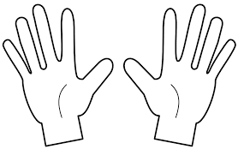
Exercise
Camera on is optional
Put your hands in front of you as on the picture
Listen to the statements:
if the statement is true keep your fingers raised
if false, lower a finger.
Notes:
The next thing you can do, is understand your privilege. I’m going to do a short exercise with you now which I’d really love you to take part in and get involved. Your camera is optional, but please be aware that it may lead to disclosing some personal information about yourself so you’re also welcome to keep your camera off if it will make you more comfortable.
Put your hands in front of you as on the picture. I’m going to read out 10 statements. If the statement is true, keep your fingers raised. If false, lower a finger.
I can go shopping alone most of the time, confident that I will not be followed or harassed by security
I can hold my partner’s hand in public without having to look over my shoulder
I have never been misgendered/referred to by the wrong pronoun
I could easily buy books, greeting cards, dolls and children’s magazines featuring people who look broadly like me/my children
I’ve never felt like I’ve had to change my accent in order to be respected/socially accepted
I can walk home at night without fear of being attacked
I can talk openly about my mental health without worrying about appearing weak to my friends
My parents/carers could afford to pay for my school meals as a child
The majority of homes I go into accommodate my physical needs
I’ve never felt that having a child may have an impact on my career
Post in the chat (if you feel comfortable doing so) how many fingers are remaining.
What do the remaining fingers represent? Answer=privilege

Slide 26
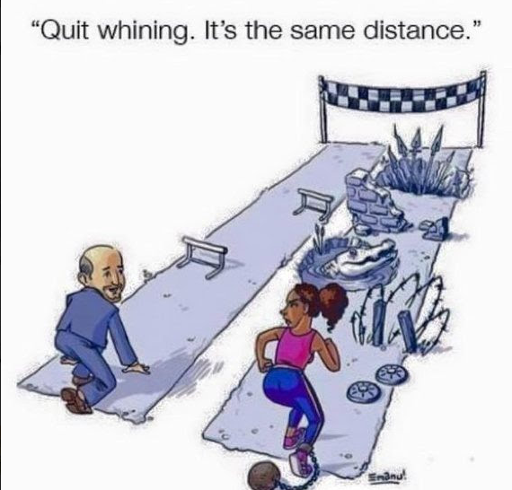
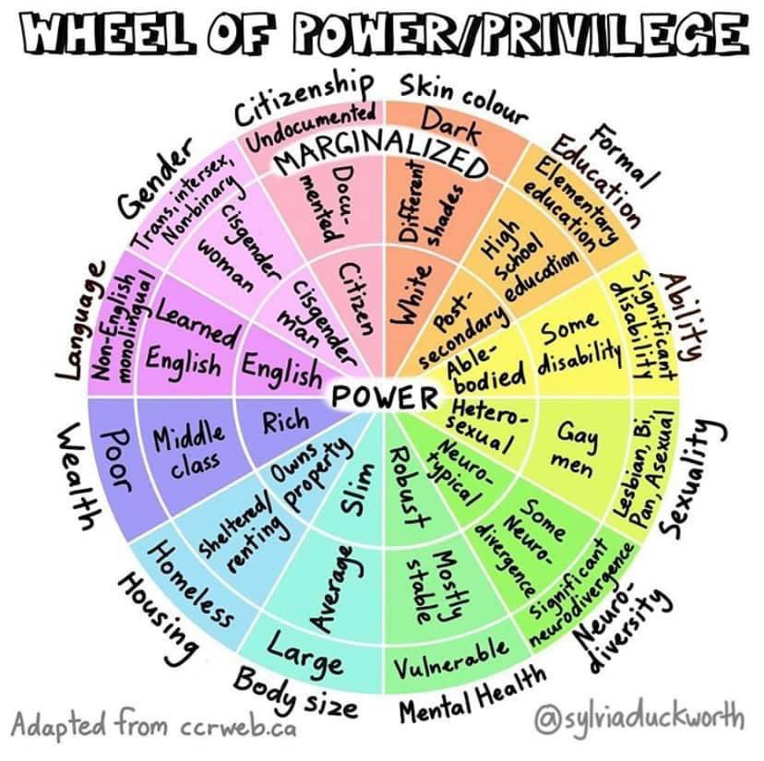
Notes:
What is privilege? Privilege is defined as ‘a special right, advantage, or immunity granted or available only to a particular person or group.’
Many people who have privilege don’t even realise it exists. This can mean that people can often think something isn’t a problem just because it’s not a problem to them personally.
It’s important to note that there is nothing wrong with having privilege. We all have it at some point, and we can all lose it very easily. We often can’t help the privilege we’ve got – it’s usually something we are born with.
What is important is what we do with it.

Slide 27
Use your privilege
There’s nothing wrong with having privilege – it’s how we use it that matters

Slide 28
Allyship ‘Allyship is an active and consistent practice of using power and privilege to achieve equity and inclusion while holding ourselves accountable to marginalised people’s needs’

Slide 29
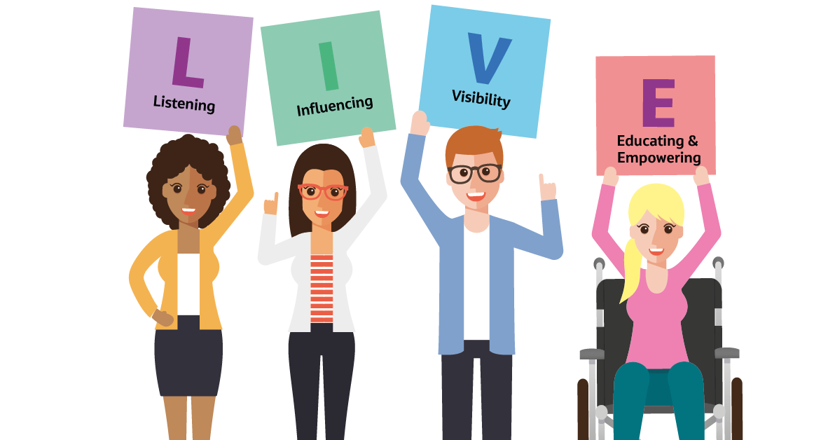
LIVE being an ally
By this we mean understanding that you have a crucial role in creating an inclusive environment everyday. This is achieved through:
Listening
Influencing
Visibility
Educating and empowering
Remember – ally should be a verb, not a noun!

Slide 30
Thank you. Questions?
Notes:
Sue

